Slide 1
Reconsidering Rectal Cancer Treatment

Slide 2
Καρκίνος ορθού
Δεδομένα που επαναπροσδιορίζονται
Λεμφαδένες μεσο-ορθού - νεοεπικουρική θεραπεία
Νεοεπικουρική χημειοθεραπεία
Ακτινοθεραπεία μικρής διάρκειας
Ανατομικά στοιχεία

Slide 3
PRIMARY SURGERY

Slide 4
Netherlands Cancer Registry between 2003 and 2014

Slide 5
THE CURRENT STANDARD OF CARE MANAGEMENT OF LOCALIZED RECTAL CANCER: Lymph nodes may only affect your local recurrence rate if you don’t do a full mesorectal excision and you leave them inside the patient Rob Glynne-Jones 2020 ESMO SUMMIT RUSSIA

Slide 6
Gunderson LL ’s published series
involvement of the CRM was not reported either preoperatively or on histopathology, and this may account for the high LR rates
CR07 and Dutch TME
preoperative staging using MRI was not used to determine which patients were most at risk of local failure
patients with CRM positive disease were not excluded from these studies because they were not identified preoperatively
investigators recognized that there was substantial overtreatment of many patients, exposing them to the long term toxicity of radiotherapy and that there was a need to define subsets of patients in whom total mesorectal excision (TME) alone is adequate loco-regional treatment

Slide 10
February 2002 - October 2003
11 hospitals UK, Berlin, Stockholm
Rectal cancer inferior margin 15cm from anal verge
All TME
No postop radiotherapy
Postop chemotherapy for node positive mainly single agent fluoropyrimidine

Slide 15
potentially involved margins
98 / 374 (26%)
preoperative CRT
81 (83%)
tumor regression - negative pCRM
60 (74%)
remained positive pCRM
21 (26%)
Local Recurrence
7 (12%)
Local Recurrence
8 (38%)

Slide 18
MRI for CRM involvement
PPV 53%, NPV 94%, sensitivity 64%, specificity 91%, accuracy 87%
mrCRM involvement resulting in positive pCRM odds ratio for was 17.36
(95% CI, 8.87 to 33.99; P .001).
mrCRM involved versus mrCRM clear resulting in positive CRM relative risk 8.67
(95% CI, 5.30 to 14.19;P.001).
Poor survival outcomes with high failure rates for distant recurrence were observed for mrCRM involvement despite 82% of these patients receiving preoperative therapy.
Such patients may have better long-term outcomes from neoadjuvant combination chemotherapy before pelvic radiotherapy and both occult distant and local tumor regression from the CRM could be achieved

Slide 19
Br J Surg 2018 Oct;105(11):1519-1529

Slide 20
January 2007 - September 2016, 10 hospitals

Slide 21
cancer of the rectum : tumour 16 cm or less from anal verge (rigid sigmoidoscope)
partial mesorectal excision (PME) for the upper third of the rectum
quality mesorectal excision
- mesorectal 398 / 428 (93 % )
- intramesorectal 23/428 (5⋅4%)
- in the muscularis propria 7/428 (1⋅6%)
pCRM+ was related to the quality of mesorectal excision (P <0⋅001).
TME quality significantly lower after nCRT than after primary surgery (P <0⋅001).
TME quality lower in patients with low rectal (P =0⋅009)
follow up 60 months (range 0–106)

Slide 22
Primary surgery 3-year LR 1⋅2% , 5-year LR 2⋅0%
Surgery after CRT 3-year LR 1⋅2%, 5-year LR 2⋅3%

Slide 23
Phase 2 Nonrandomized QuickSilver Clinical Trial
12 high-volume colorectal surgery centers across Canada, 82 patients
MRI criteria for good prognosis tumors
distance to MRF > 1mm
from the primary tumor, discontinuous tumor nodule, or suspicious lymph node
T2, T3 < 5mm extramural depth of invasion
absent or equivocal EMVI
N0-N2 disease were eligible
Rectal cancer : 15 cm from anal verge on endoscopy and proximal extent of the tumor at or below the sacral promontory on MRI
PME or TME, no intersphincteric or APR

Slide 24
Phase 2 Nonrandomized QuickSilver Clinical Trial
Recommended adjuvant treatment
no further treatment for negative CRM and negative lymphnodes
adjuvant chemotherapy for negative CRM and positive lymphnodes
postoperative CRT ± adjuvant chemotherapy for positive CRM
regardless of nodal status

Slide 25
Phase 2 Nonrandomized QuickSilver Clinical Trial
EMVI was present in 16% (13 of 82).
MRI suspicious lymph nodes 37% [n = 30]
Pathology positive mesorectal lymph nodes 29% [n = 24]
agreement for lymph nodes between MRI and pathology 68.3%
10 cases (12%) under staged, 16 cases (20%) over staged
PPV 46.7%, NPV 80.7%

Slide 26
Phase 2 Nonrandomized QuickSilver Clinical Trial
positive CRM 4.9% [ n = 4/82]
discontinuous tumor nodule not visualized on MRI review - CRT + CT
primary tumor at the level of the intersphincteric space (handsewn) - CT
primary tumor 14w between MRI and surgery patient comorbidity - CRT + CT
positive lymph node lymph node was not visualized on MRI review - CT

Slide 27
Phase 2 Nonrandomized QuickSilver Clinical Trial
Results of this study suggest that in high-volume centers, the
use of MRI criteria to identify patients with good prognosis rectal
cancer for primary surgery results in a positive CRM of less
than 5%.
These findings suggest that CRT may not be necessary for all patients with stage II and III rectal cancer.

Slide 29
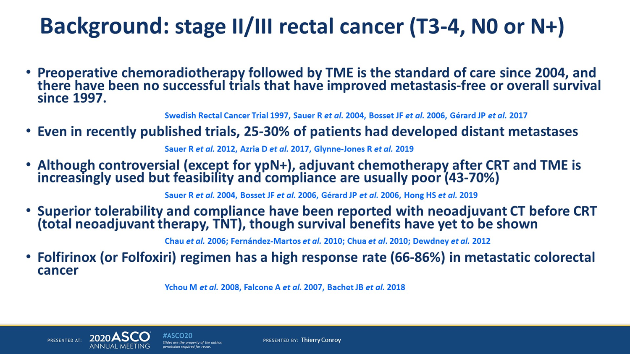

Slide 30
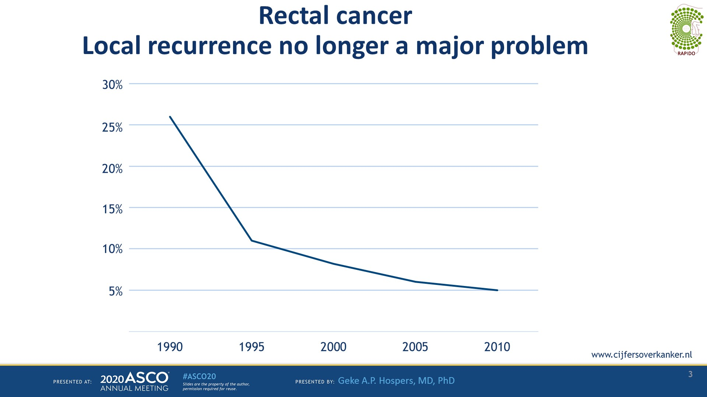
Slide 3
Presented By Geke Hospers at TBD

Slide 34
TOTAL NEOADJUVANT CHEMOTHERAPY

Slide 35
ΠΠPCR
ΠΠDFS
ΠΠSPS

Slide 36
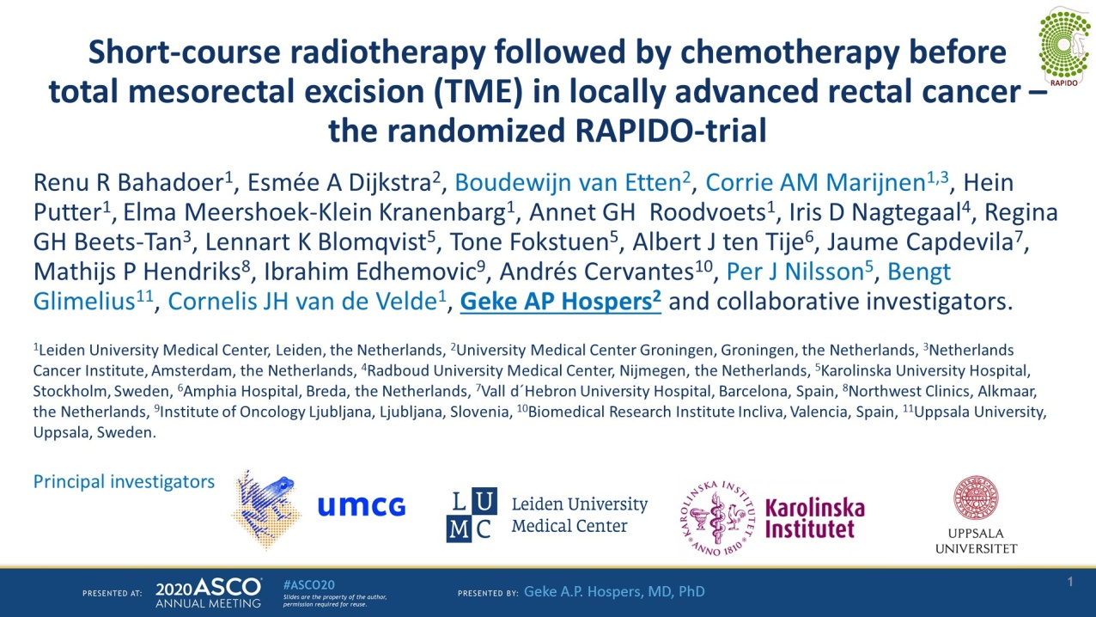
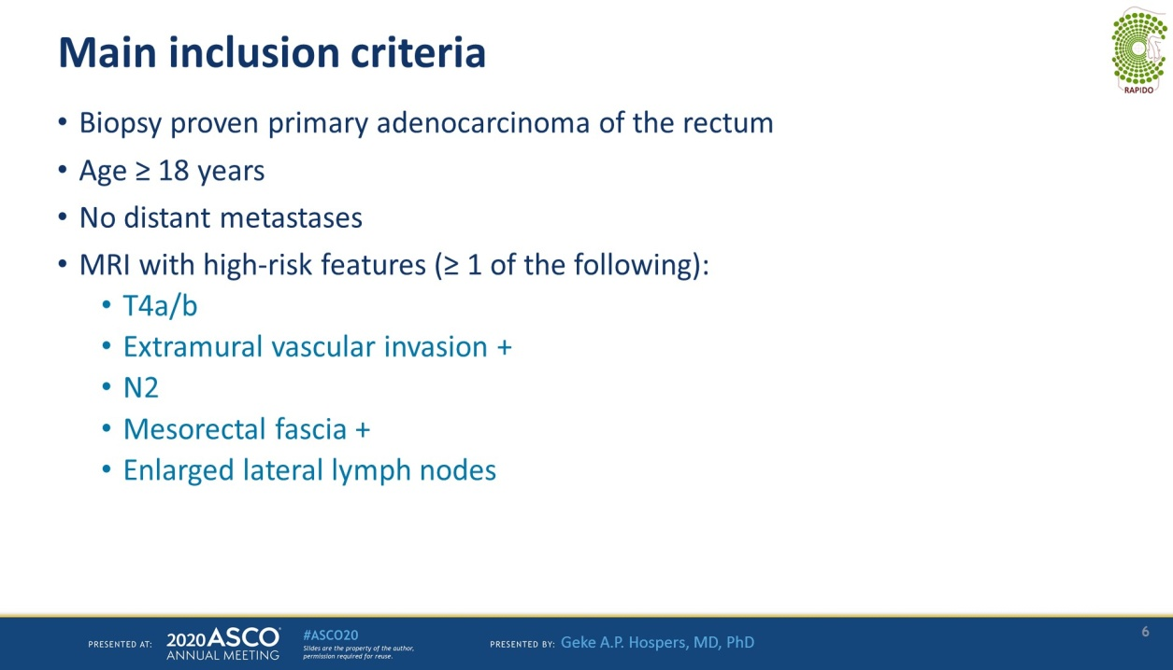
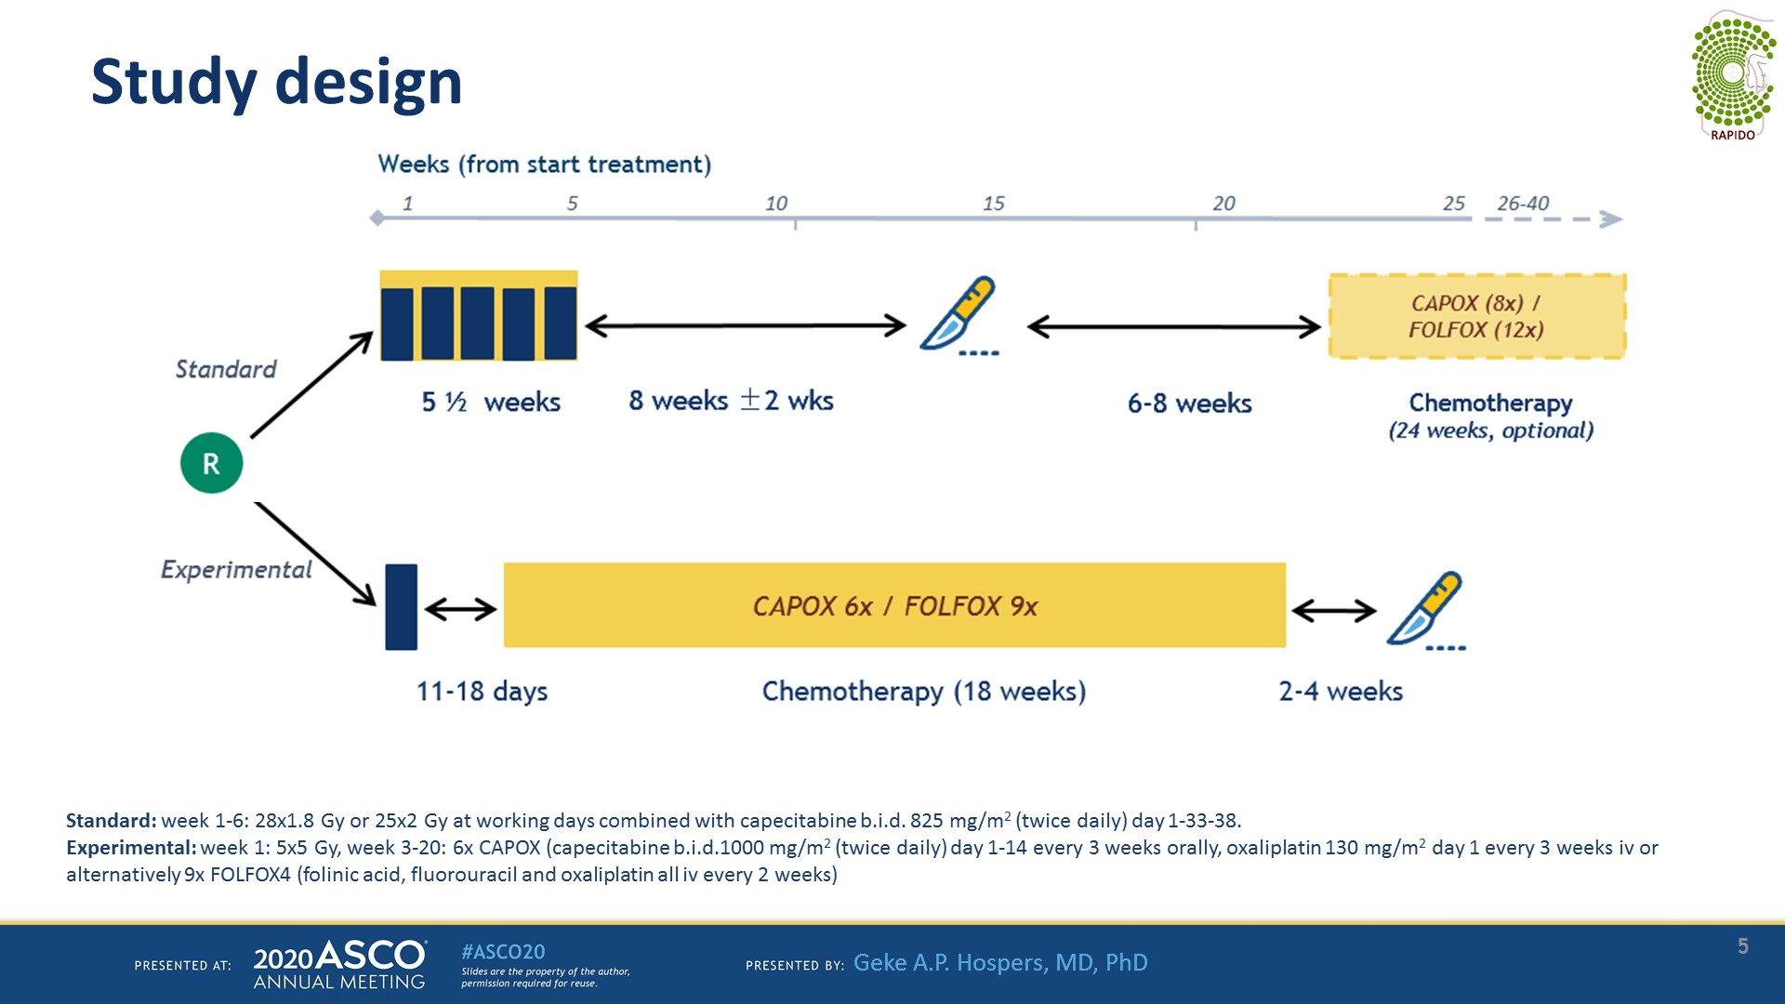

Slide 37
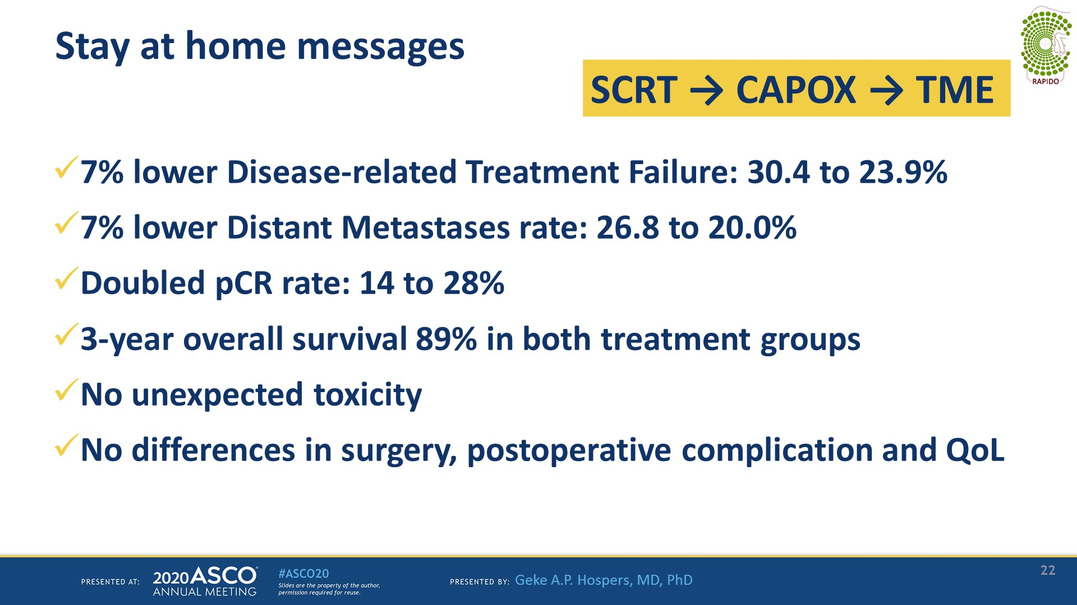
Stay at home messages
Presented By Geke Hospers at TBD

Slide 41
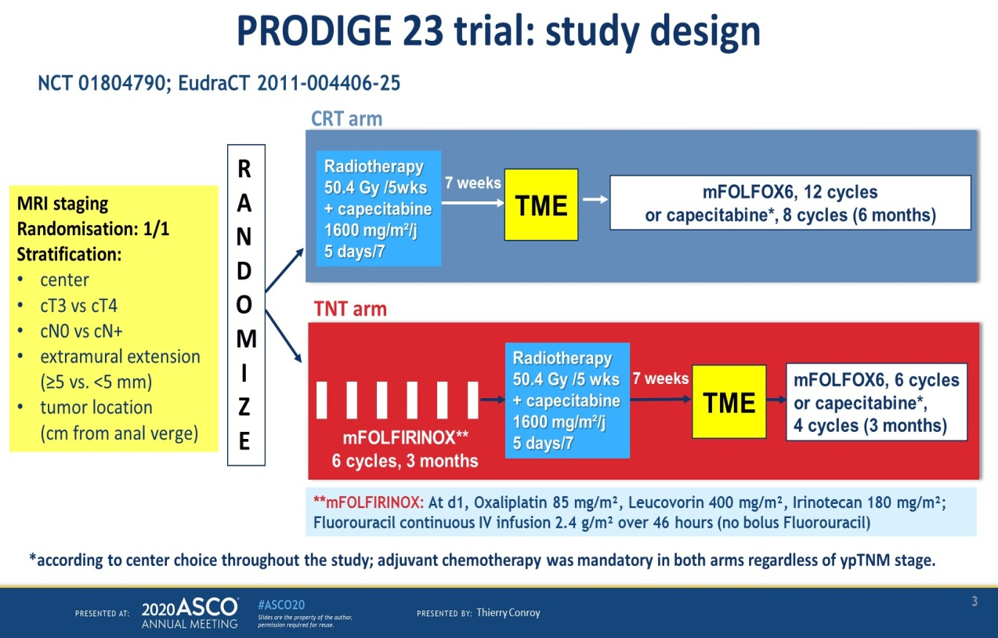
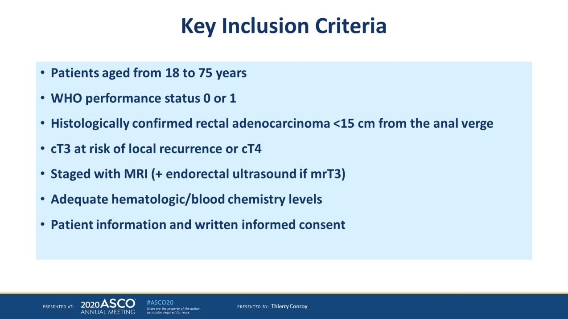

Slide 42
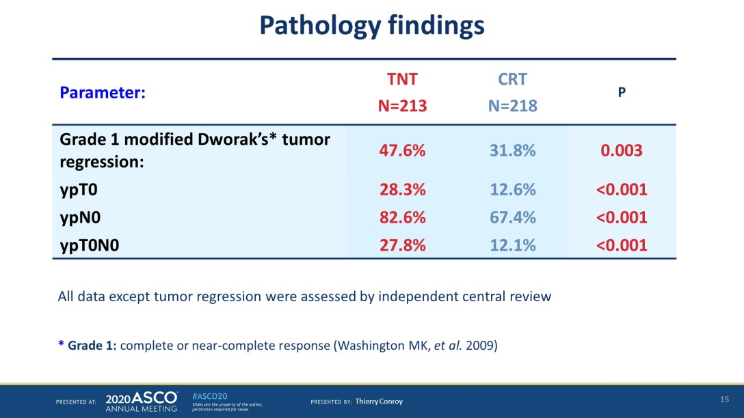
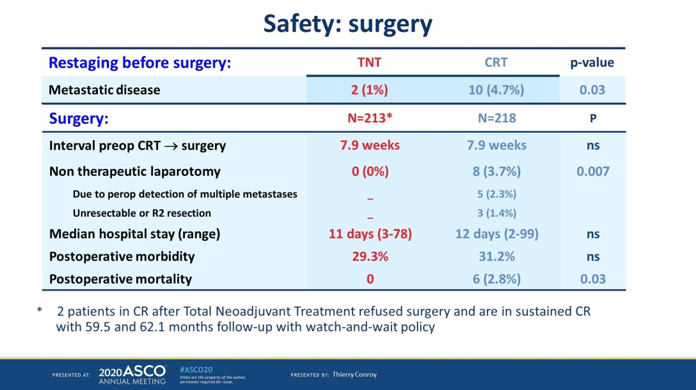
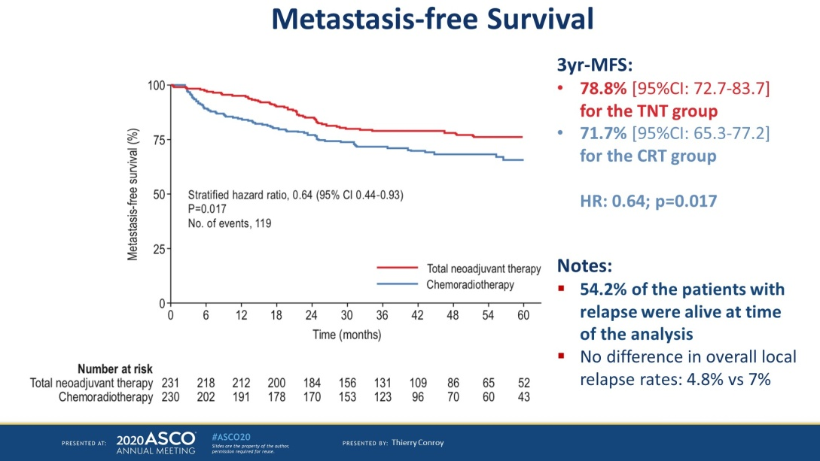
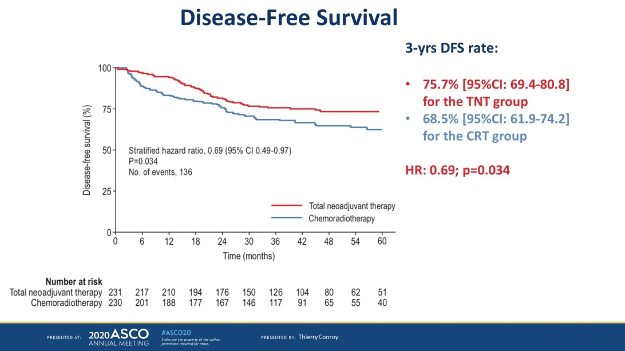

Slide 43
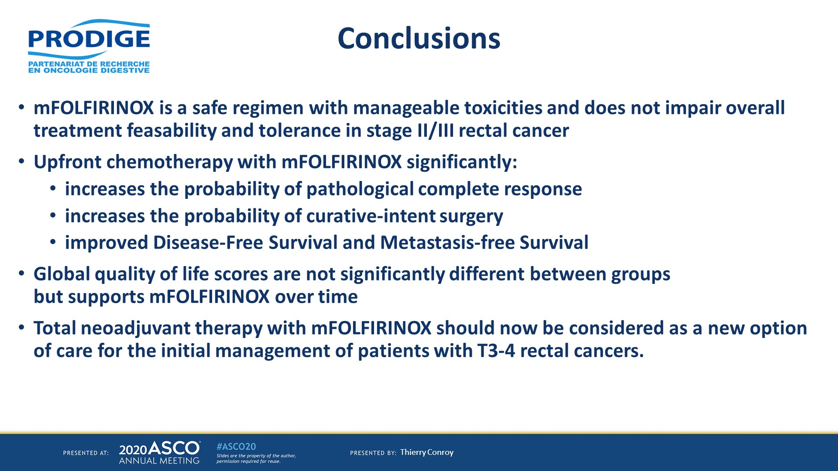

Slide 44
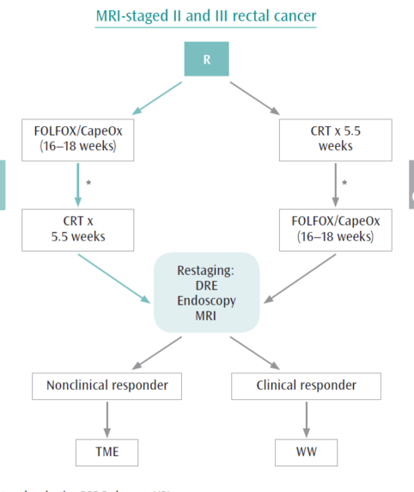
DOI:10.1200/jco.2020.38.15_suppl.4008Corpus ID: 219777675
Preliminary results of the organ preservation of rectal adenocarcinoma (OPRA) trial.
J. Garcia-Aguilar, S. Patil, +5 authors L. Saltz
Published 2020
Medicine
Journal of Clinical Oncology
3-year rates with 95% CI.
 | Induction |  | Consolidation |  | p*
DFS | 78% | (70%,87%) | 77% | (69%,86%) | 0.90
DMFS | 81% | (74%,90%) | 83% | (76%,91%) | 0.86
OP | 43% | (35%,54%) | 58% | (49%,69%) | 0.01

Slide 45
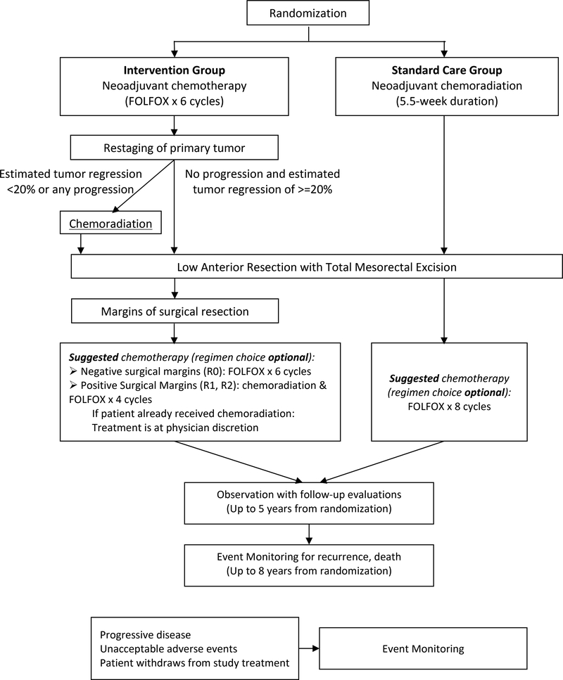
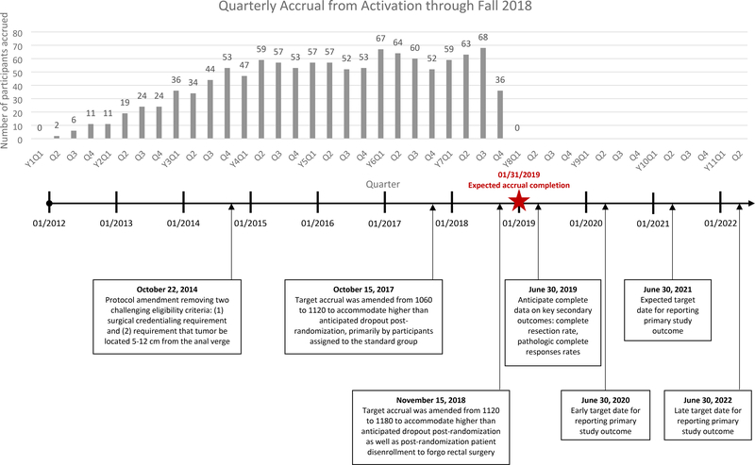
PROSPECT trial (N1048)
≥ 18 y, rectal adenocarcinoma
For this patient, the standard treatment recommendation in the absence of a clinical trial would be combined modality neoadjuvant chemoradiation followed by curative intent surgical resection
Candidate for sphincter-sparing surgical resection prior to neoadjuvant therapy according to the primary surgeon
Primary surgeon is credentialed or is willing to be credentialed in Total Mesorectal Excision (TME), which entails submission of photos of a single TME specimen either before enrolling the first patient or by using the surgeon's 1st accrued case.
Clinical Stage: T2N1, T3N0, T3N1.

Slide 46
NEO-ADJUVANT TREATMENT FOR ADVANCED RECTAL CANCER WITH CHEMOTHERAPY
A MULTICENTER PHASE II - SAFETY TRIAL
NEARCHO-II
Phase II Multicenter Trial assessing safety and feasibility of neo-adjuvant
chemotherapy with mFOLFOX followed by surgery
for the locally advanced rectal cancer
Any of the following at the MRI staging:
o T3c, T3d
o Involved mesorectal lymph nodes (N1, N2)
o Any T3 or involved lymph node at <2mm from mesorectal fascia
o Presence of extramural venous invasion

Slide 47
The combination of perfusion fraction (F) and tumour volume (V)
(Fpre/Vpre) measured by DW MRI gave the highest prediction of poor tumour response (AU
0.93, p<0.001) with a sensitivity of 88% and a specificity of 91%, and also predicted PFS (progression free survival) (p<0.01)
Bakke KM Acta Oncol 2017

Slide 48
SHORT COURSE RADIOTHERAPY

Slide 49
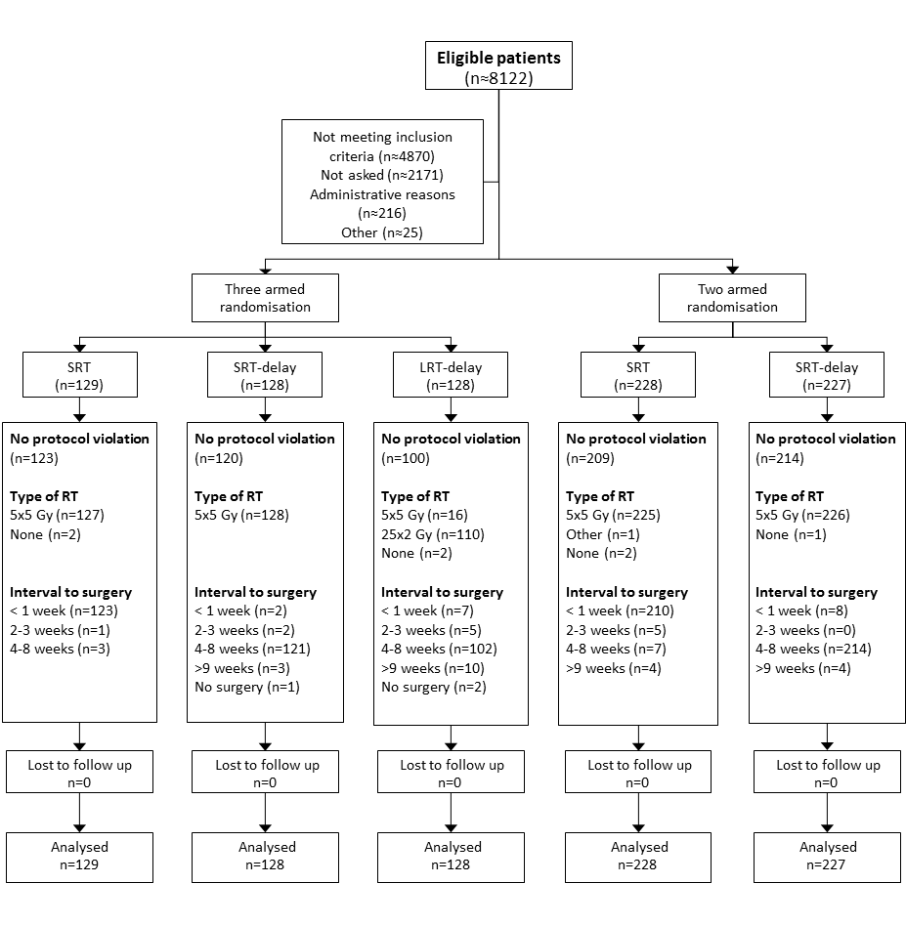
Clinically primary operable, prognosis-verified adenocarcinoma of the rectum. No signs of distant metastases
The Stockholm III Trial on optimal fractionation of preoperative radiotherapy and timing to surgery for rectal cancer - a randomised controlled trial.
Johan Erlandsson MD ¹, Torbjörn Holm Prof ¹, David Pettersson PhD ², Åke Berglund PhD ³, Björn Cedermark PhD ¹, Calin Radu PhD ³, Hemming Johansson Msc ⁴ , Mikael Machado PhD ⁵, Fredrik Hjern PhD ⁵, Olof Hallböök Prof ⁶, Ingvar Syk PhD ⁷, Bengt Glimelius Prof ³, Anna Martling Prof ¹
The Lancet Oncology 2017; 18(3): 336-46

Slide 50
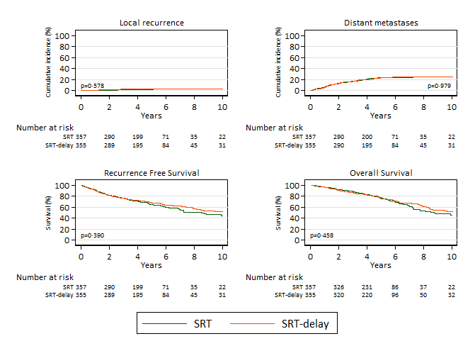
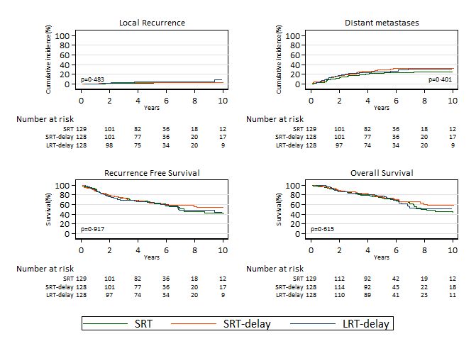
Delaying surgery after SRT gives similar oncological results compared to SRT with immediate surgery. Although radiation induced toxicity was seen after SRT-delay and LRT-delay, the risk of surgical complications was significantly reduced by delaying surgery. LRT-delay has no advantage compared to SRT-delay, but prolongs the treatment time substantially.

Slide 52
5 eligible studies, 1244 patients
SCRT- DS higher pCR and downstaging, fewer postoperative complications (not AL)
OS, sphincter preservation rate and R0 rate similar
Recommended short-course radiotherapy with delayed surgery for more than 4 weeks

Slide 55
SCRT – delayed surgery vs LCRT
Wang Quoli et al, metanalysis 2019
SCRT with CT / DS vs LCRT no statistically significant differences in terms of OS, DFS, pCR, treatment-related grade 3/4 toxicity, PCs, local recurrence (LR), or DM.
SCRT without CT (consolidation or adjuvant)/DS vs LCRT
- lower treatment-related grade 3/4 toxicity but significantly lower OS and pCR
- no significant differences with regard to DFS, DM, PCs, or LR
In summary
our meta-analysis found that SCRT - delayed surgery had similar efficacy and side effects compared with LCRT and that adding additional chemotherapy to the SCRT group resulted in few advantages over the long-course radiotherapy group.

Slide 57
No statistically significant difference was found in overall mortality and metastasis between SCES, SCDS, and LCDS.
For overall metastasis, SCES was the most likely to be effective, followed by LCDS and SCDS.
SCRT had a lower overall mortality rate than LCRT.

Slide 58
Προβληματισμοί σε βασικά θέματα χειρουργικής ανατομίας
Η συζήτηση για νέο – επικουρική θεραπεία ξεκινά από την παραδοχή ότι πρόκειται για καρκίνο του ορθού και όχι του σιγμοειδούς
Πως ορίζεται το ορθό;
Τα κριτήρια για την νέο-επικουρική θεραπεία του κατώτερου και του ανώτερου ορθού διαφέρουν από του μέσου
Τα κριτήρια της επικουρικής θεραπείας του ανώτερου ορθού διαφέρουν
Η χειρουργική θεραπεία επίσης προσαρμόζεται, κυρίως στο ανώτερο ορθό
Πως διαχωρίζονται τα τμήματα του ορθού;

Slide 59
P156 Nice 2018
Variation in landmarks for the rectum: an MRI study
D'Souza N, Balyasnikova S, Tudyka V, Lord A, Shaw A, Abulafi M, Tekkis P, Brown G.
Colorectal Dis. 2018 Oct;20(10):O304-O309
100 ασθενείς
Οριοθέτηση ορθού από σιγμοειδές – συμβολή μεσοορθού και μεσοσιγμοειδούς
Σύγκριση με την οριοθέτηση με μετρικό σύστημα και οστικά σημεία αναφοράς
Μέση απόσταση της έναρξης σιγμοειδούς από το πρωκτικό όριο 12.6 cm (SD 1.8 cm, 9.4-19.0 cm)
Στα 12 cm, υπήρχε σιγμοειδές και όχι ορθό σε 35% των ασθενών
Στα 15 και 16 cm, υπήρχε σιγμοειδές σε 84% και 96% των ασθενών
Στο ακρωτήριο των μαιευτήρων και στο Ι3 υπήρχε σιγμοειδές σε 100 % και 28 % των ασθενών

Slide 60
Definition of the Rectum: Round 2 Feb 21, 2018
Dear Colleague,
Thank you again for participating in the consensus to achieve a reliable and clearly identifiable cut-off point for the rectum. You are invited to participate in the second round for the definition of the rectum. This includes the results of the first survey, in which a consensus was generated. In this round, we summarise the consensus definition, and give you an opportunity to specify any reasons to remain outside the consensus.
Please follow this link to complete the survey, which should take no more than 10 minutes to complete. We look forward to your feedback about this definition.
If you have further comments to make outside of the survey, please e-mail us at rectumdefinition@gmail.com
With best wishes,
Gina Brown
Consultant Radiologist and Professor of Gastrointestinal Imaging, Royal Marsden NHS Foundation Trust and Imperial College London, UK
Theo Wiggers
Professor (Emeritus) in Surgical Oncology, University Medical Center Groningen, The Netherlands
Nigel D’Souza
Colorectal Research Fellow, Royal Marsden NHS Foundation Trust
Michael de Neree
Colorectal Research Fellow, Academic Medical Center, Amsterdam

Slide 61
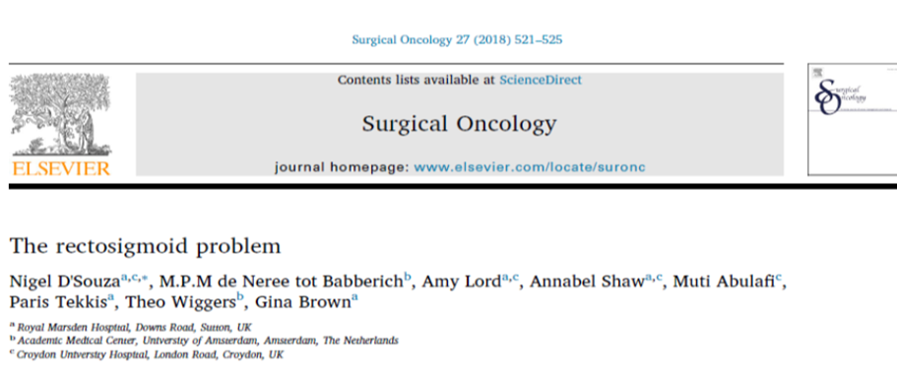
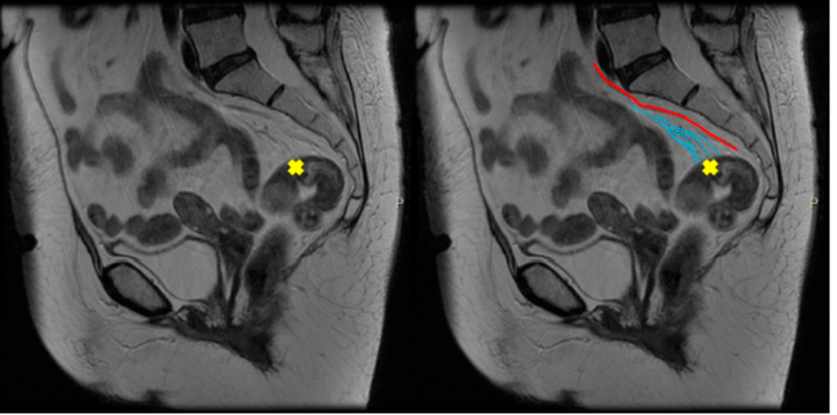
Sigmoid take-off
D'Souza N, Lord A, Shaw A, Patel A, Balyasnikova S, Tudyka V, Abulafi M, Moran B, Rasheed S, Tekkis P, Terlizzo M, West N, Quirke P, Brown G,
The sigmoid take-off: An anatomical imaging definition of the rectum validated on specimen analysis,
European Journal of Surgical Oncology (2020)
Πρέπει να γίνουν νέες μελέτες για το «νέο ορθό», όπως αυτό ορίζεται με την μαγνητική τομογραφία;
Το σημείο που το ορθό, σταθεροποιημένο στο ιερό με το μεσο-ορθό, απομακρύνεται και το μεσόκολο πια επιμηκύνεται. Το έντερο φαίνεται στις εγκάρσιες τομές να στρέφεται προς την κοιλιά και να οριζοντιώνεται στις οβελιαίες τομές.
ΑΤ αγγειογραφία τα σιγμοιειδικά αγγεία κεντρικά και η άνω ορθική διχάζεται περιφερικά του σημείου

Slide 62
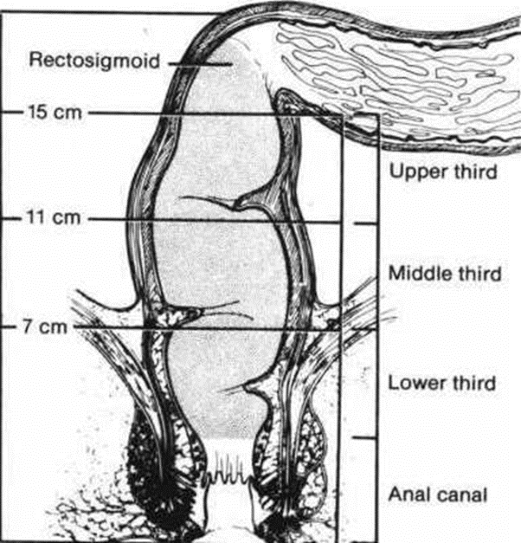
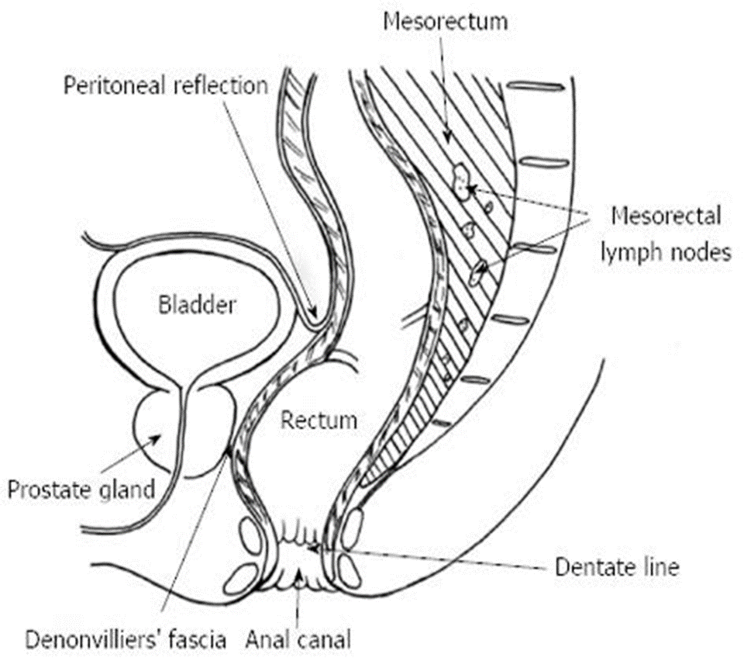



Διαχωρισμό του ορθού σε τμήματα
16cm
12cm
10 cm
6cm
5cm

Slide 63
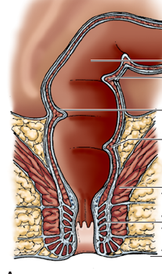
Διαχωρισμός με μαγνητική τομογραφία - μόνο ανατομικά σημεία
Κατώτερο ορθό :πρωκτικό όριο έως και τον ηβορθικό ή τελευταία 3 - 5 εκ (κατώτερο - εξωπεριτοναϊκό ορθό)
Μέσο ορθό: ηβορθικό έως και πρόσθια ανάκαμψη του περιτοναίου 5 – 8εκ (ανώτερο – εξωπεριτοναϊκό ορθό)
Ανώτερο ορθό: πάνω από την πρόσθια ανάκαμψη του περιτοναίου έως sigmoid take-off ή >5-8 εκ
(ενδοπεριτοναϊκό ορθό)
συμπεριφορά όπως κόλον;
5-8 cm
3-5 cm
Που σταματά το ορθό και ξεκινά ο πρωκτός;

